Slide 1

Introduction
A course on “Data Science with Python”
Malleswar Yenugu, PhD

Slide 2

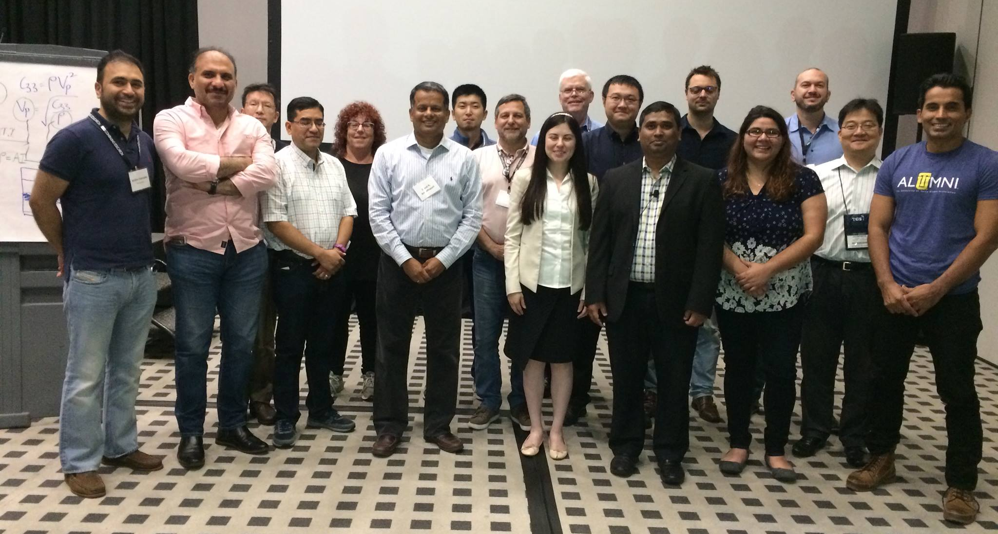
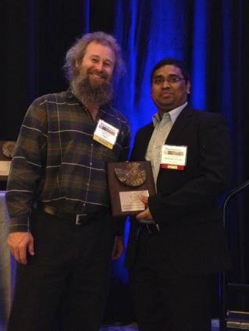
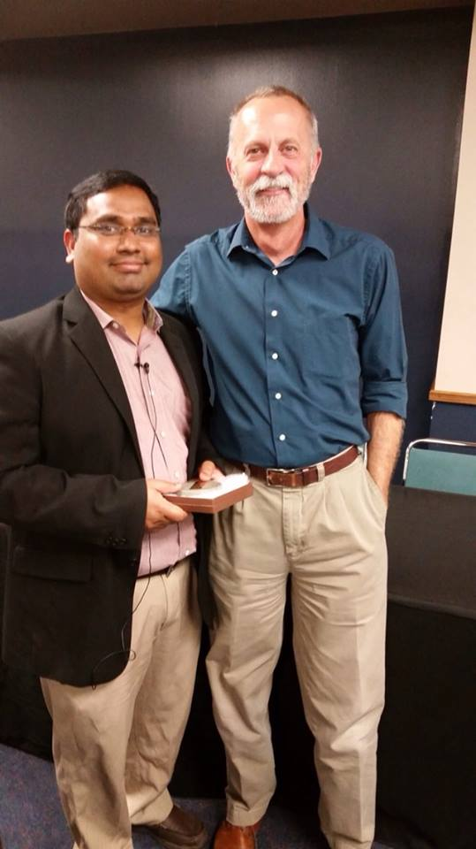
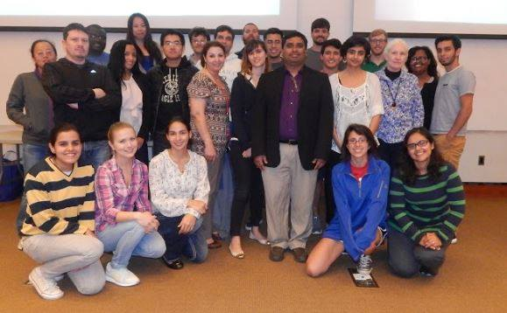
Who Am I?
PhD from University of Houston in Geophysics, currently working for oil and gas
Offered Guest Lectures at Stanford, Univ. of New Orleans, Univ.
of Tulsa, Univ. of Houston, IIT-B, Shell, ONGC, Cairn, etc.
Passionate about AI and ML

Slide 3
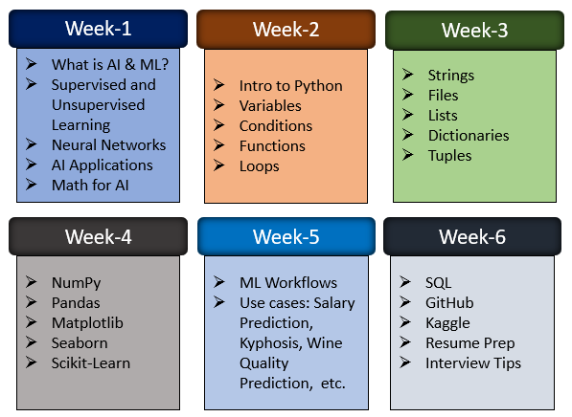
Course Outline

Slide 4
Introduction: AI and Machine Learning

Slide 5
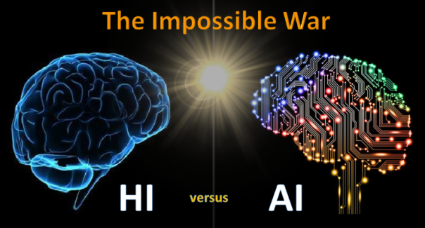
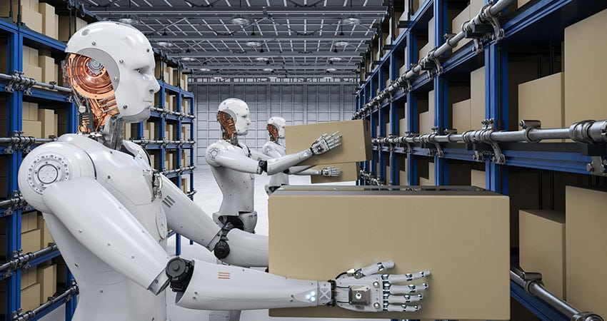
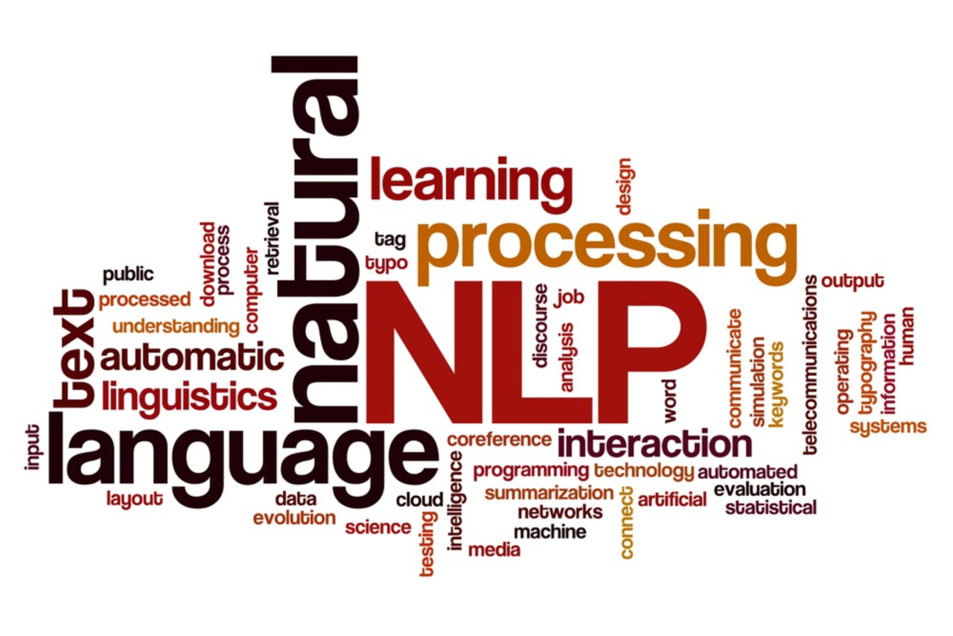

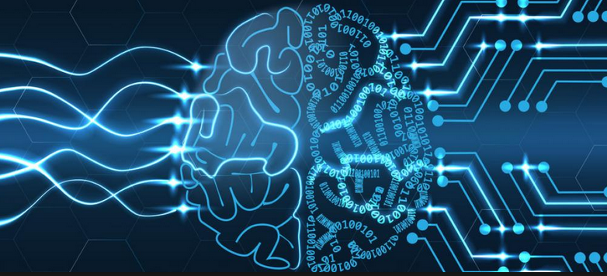
Human Intelligence (HI) vs. Artificial Intelligence (AI)
~
Robotics
NLP
Vision
Thinking & Decision Making
Machine Learning
Supervised Learning
Unsupervised Learning
Neural Networks
Deep Neural Networks

Slide 6
What will we cover today?
What is AI and ML?
Human Intelligence vs. Artificial Intelligence
Examples

Slide 7
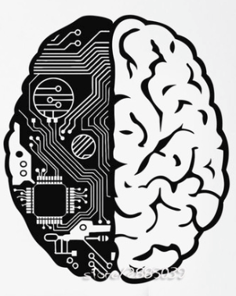
What will we cover today?
What is AI and ML?
Human Intelligence vs. Artificial Intelligence
Examples

Slide 8
What is Artificial Intelligence?
Artificial Intelligence (AI) is the science of making things smart. Can be defined as:
“Human intelligence exhibited by machines”
A broad term for getting computers to perform human tasks.

Slide 9
Conventional Computing vs. AI
Conventional Computing
Input
Logic
Output
Programmer
Artificial Intelligence
Input
Finds Logic on Own
Prediction
Output
Machine

Slide 10
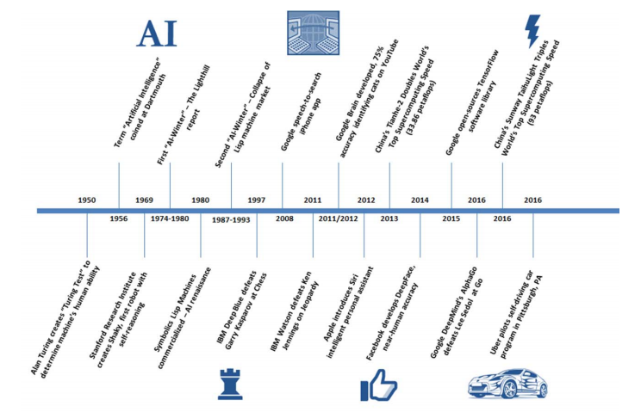
Evolution of AI

Slide 11
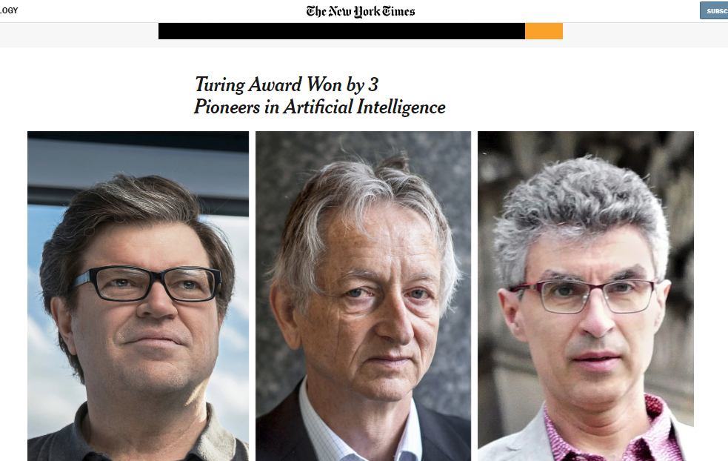
God father of AI – Dr. Geoffrey Hinton
Works at both Google Brain and Univ. of Toronto
Early researcher on “Backpropagation” algorithm
for training deep-neural networks.
Introduced image-recognition program
“ImageNet” in 2012
Currently taking care of his sick wife in Toronto
Dr. Hinton

Slide 12
Applications of AI
Object recognition
Speech recognition / sound detection
Natural Language Processing / Sentiment analysis
Creative (e.g. Style Transfer – Learning to draw an image in the style of an artist)
Prediction – given some inputs, what is the expected output for unseen examples
Translation – between languages
Restoration / Transformation – (e.g. taking an image and using ML to figure out what should be there, or generating
faces based on what it knows a face to be)

Slide 13
What is Machine Learning?
Machine Learning (ML) can be defined generally as:
“An approach to achieve artificial intelligence (AI) through systems that can learn from experience to find patterns in a set of data”
ML involves teaching a computer to recognize patterns by example, rather than programming it with specific rules.
These patterns can be found within data. In other words, ML is about creating algorithms (or a set of rules) that learn
complex functions (or patterns) from data and make predictions on it – a form of “narrow AI”.

Slide 14
ML – Learning by example
ML is all about predicting stuff. It is intelligent because:
It takes some data (to train the system)
Learns patterns from this data
Classifies new data it has not seen before for a best guess of what it probably is, based on knowledge gained from step 2.
“The beauty of ML is that it learns by itself from the data passed to it.”

Slide 15
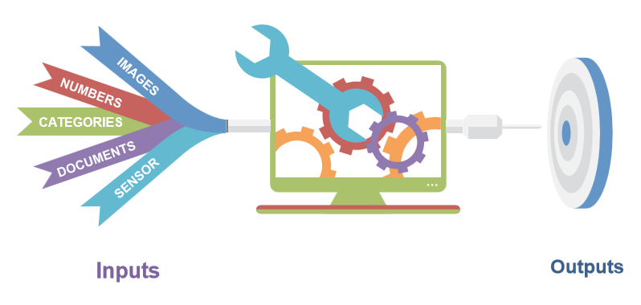
Machine Learning

Slide 16
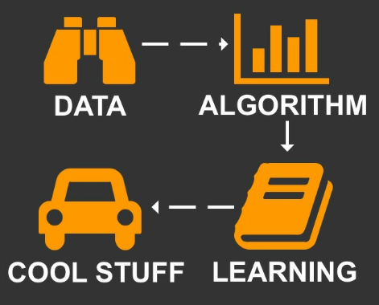
Machine Learning

Slide 17
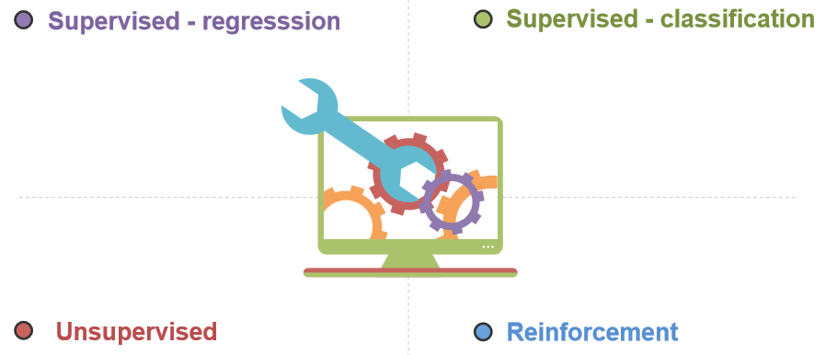
Machine Learning

Slide 18
What is Deep Learning?
Deep Learning (DL) can be defined generally as:
“A technique for implementing Machine Learning”
One such DL technique is deep neural networks (DNN)
DNNs is where the code structures are arranged in layers that loosely mimic the human brain, learning patterns of patterns.

Slide 19
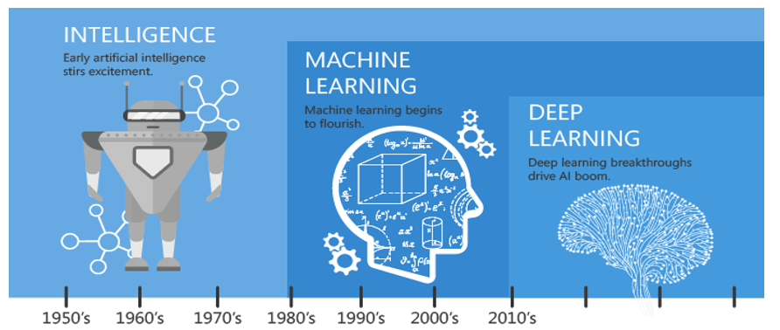
AI – ML - DL

Slide 20
Human Intelligence (HI) vs. Artificial Intelligence (AI)
~
Robotics
NLP
Vision
Thinking & Decision Making
Machine Learning
Supervised Learning
Unsupervised Learning
Neural Networks
Deep Neural Networks

Slide 21

AI – ML – DL: Examples

Slide 22
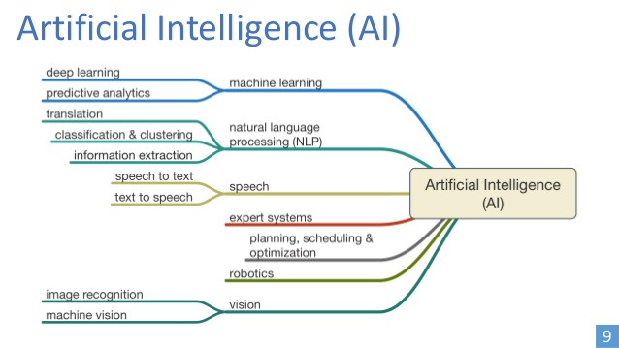
AI – ML – DL: Examples

Slide 23
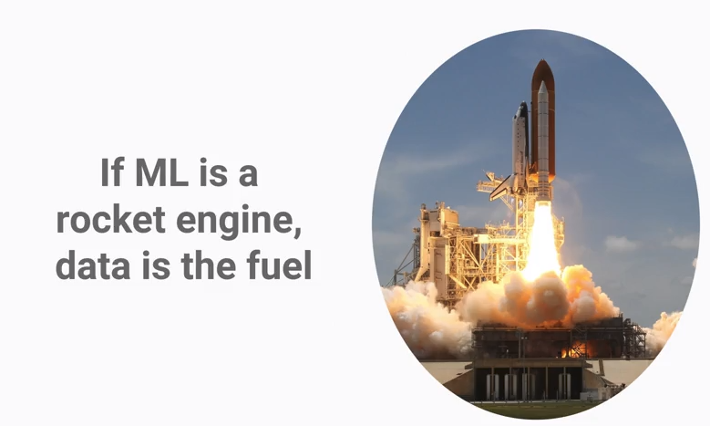
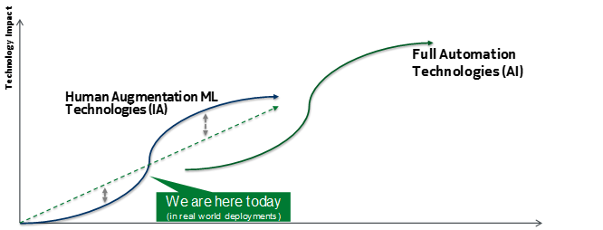
AI – Where are we now?

Slide 24
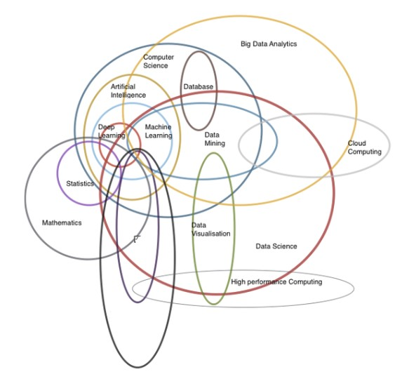
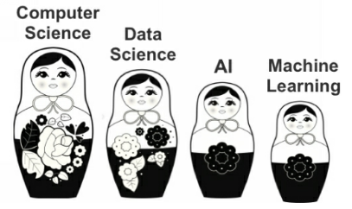
Data Science – A mixture of many disciplines
Neurocomputing

Slide 25
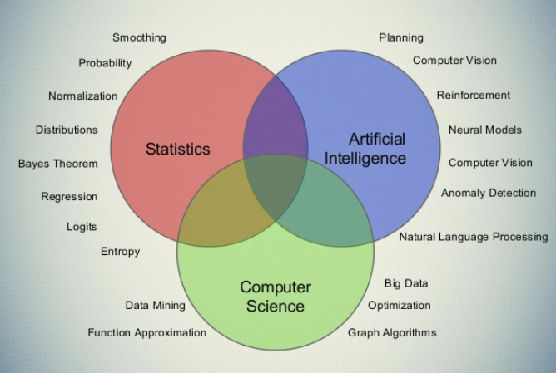

Data Science – A mixture of many disciplines

Slide 26
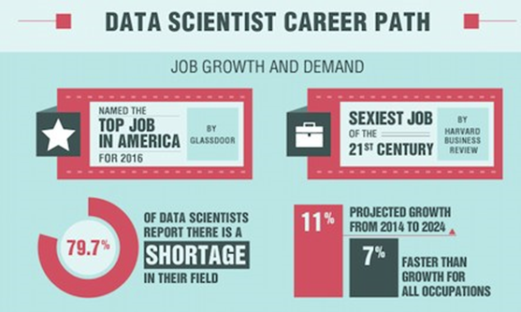
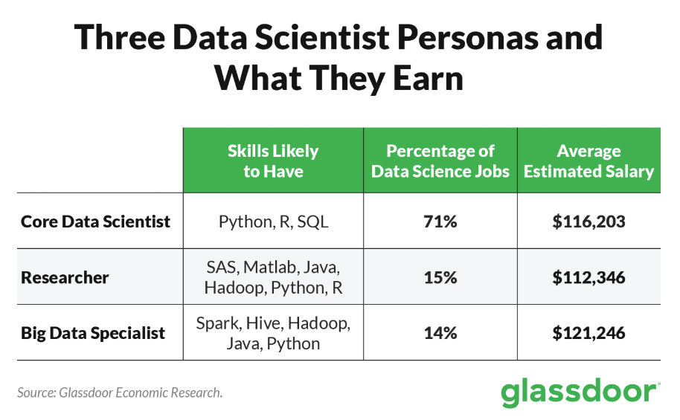
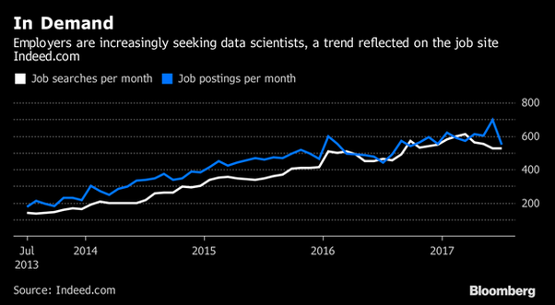
Job Demand for Data Scientists

Slide 27
What will we cover today?
What is AI and ML?
Human Intelligence vs. Artificial Intelligence
Examples

Slide 28
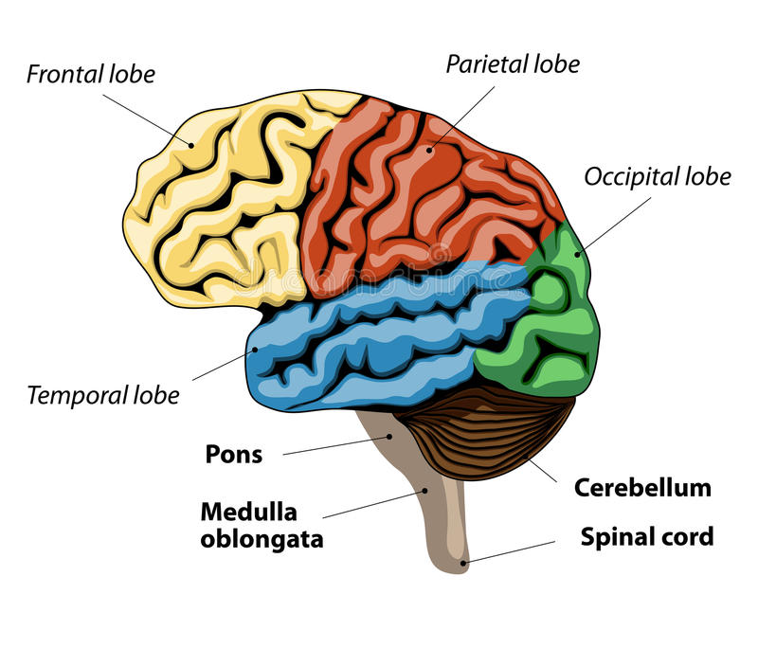
Human Brain

Slide 29
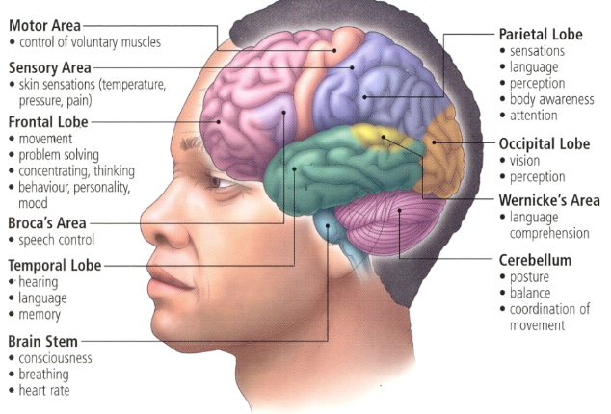
Functions of Human Brain

Slide 30
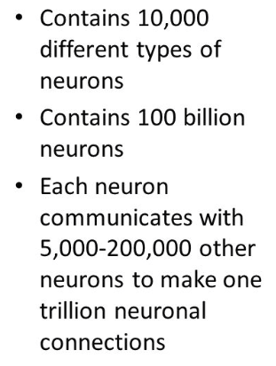
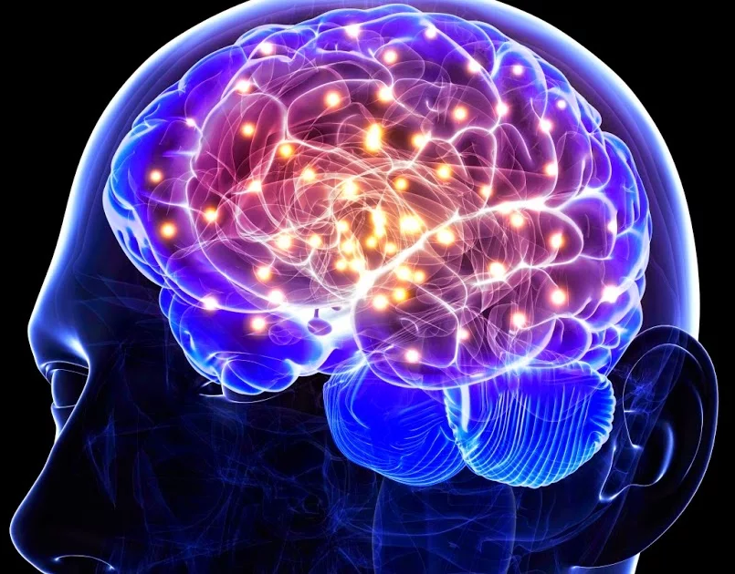
Neurons of Human Brain

Slide 31
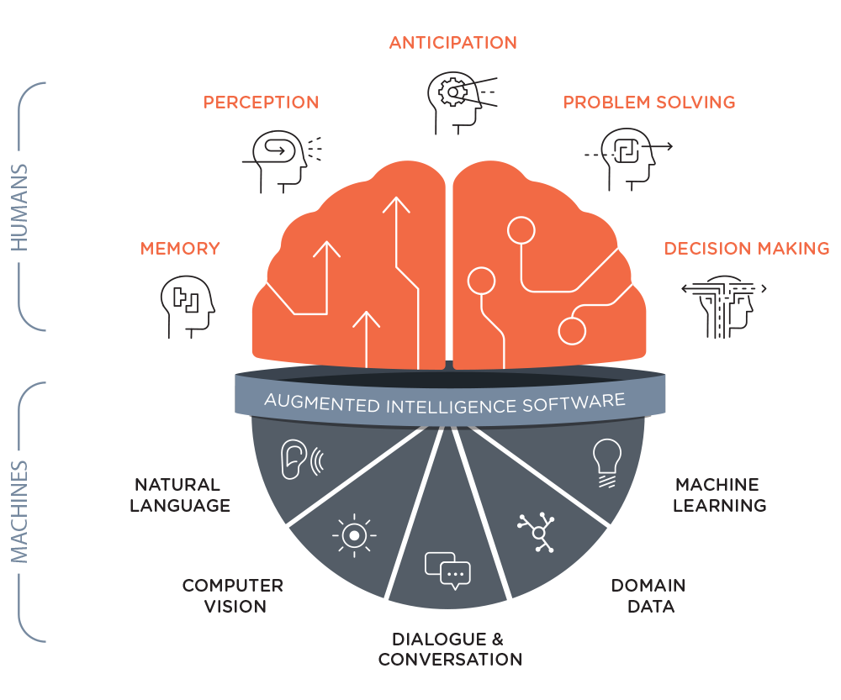
Human Intelligence vs. Artificial Intelligence

Slide 32
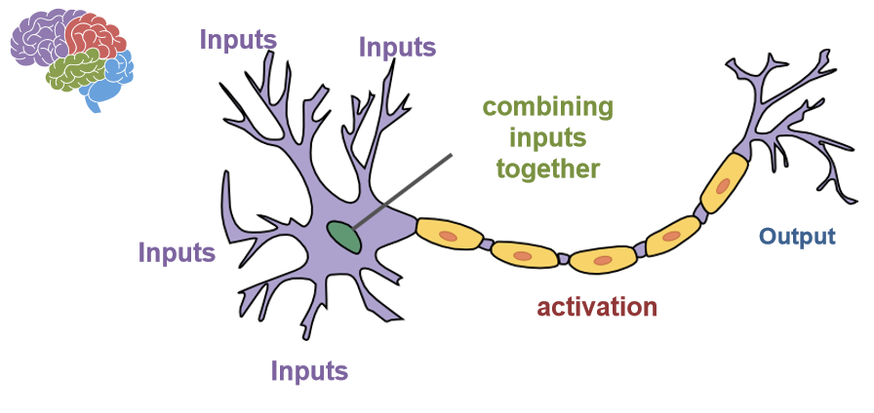
Neurons in the Brain

Slide 33
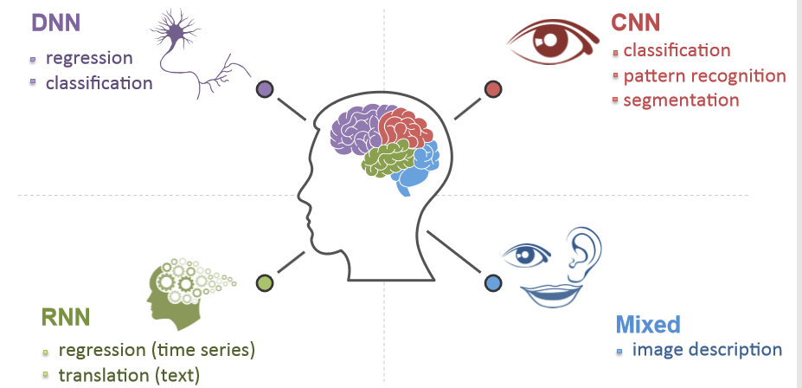
Human Brain

Slide 34
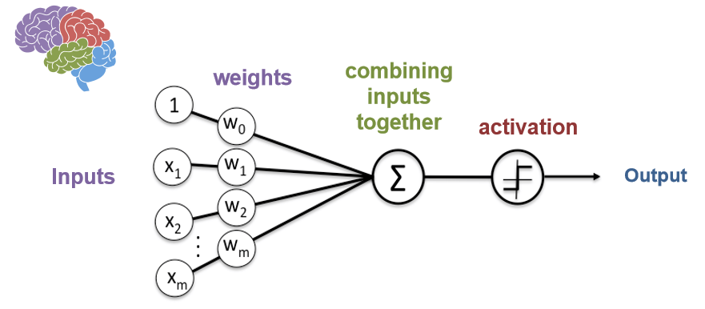
Neurons in Deep Learning

Slide 35
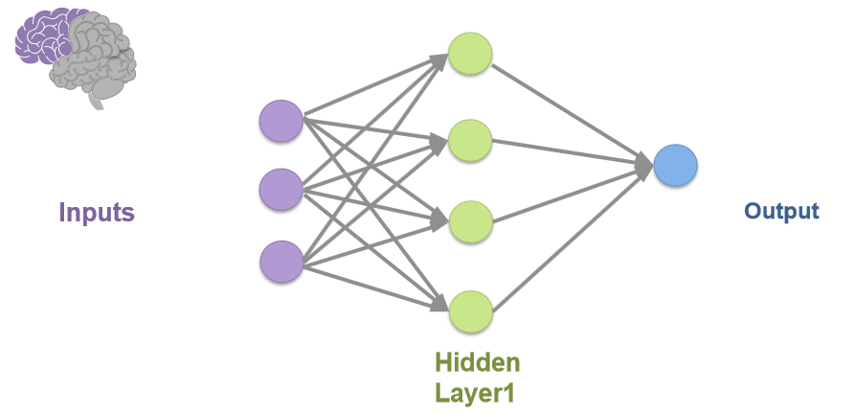
Neural Network

Slide 36
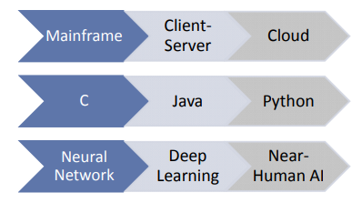
Technology Development

Slide 37
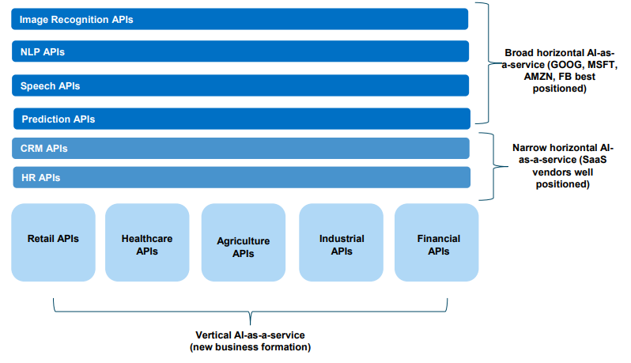
AI-as-a-Service (AI-aaS)

Slide 38
What will we cover today?
What is AI and ML?
Human Intelligence vs. Artificial Intelligence
Examples

Slide 39
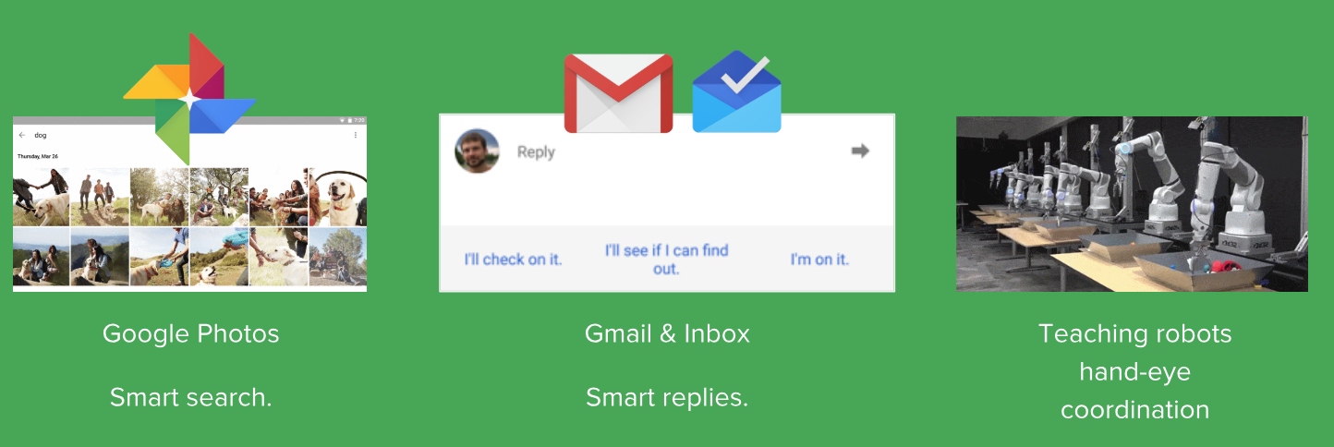
AI – ML – DL: Examples

Slide 40

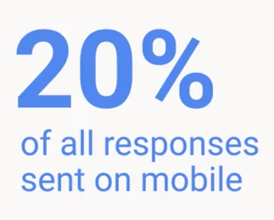
AI – ML – DL: Examples
“Most Sophisticated ML model today” - Google
Best example of “NLP”

Slide 41
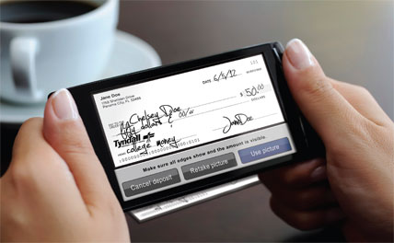

AI – ML – DL: Examples
Hand written Check Deposit
Reasons for Baby Cry

Slide 42
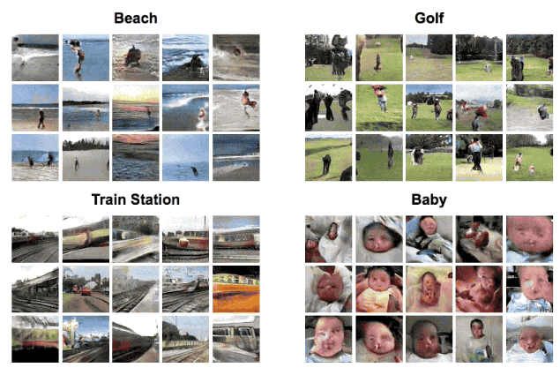
AI – ML – DL: Examples
What you see here are images (actually videos) “dreamt up” by a neural network. It studied various Videos of beaches, train stations, etc and then Given an image it has never seen before, it will Imagine what might be happening in that scene and turn it into a video.
Amazing research in its very early stages, but one to watch for the future.
Nothing you see here is “real” or actually exists.

Slide 43
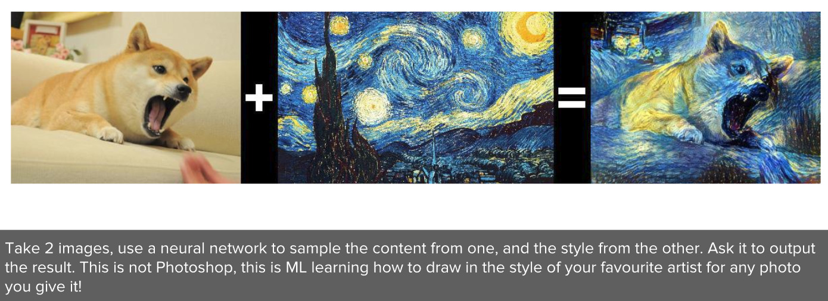
AI – ML – DL: Examples

Slide 44
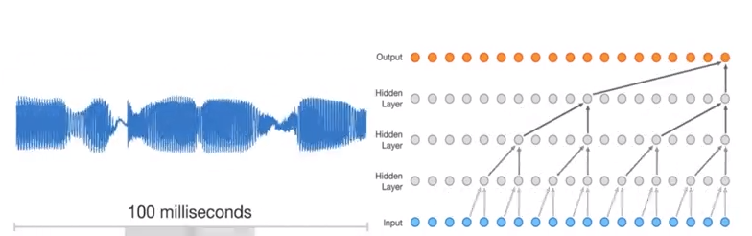
AI – ML – DL: Examples
Create your own Music

Slide 45
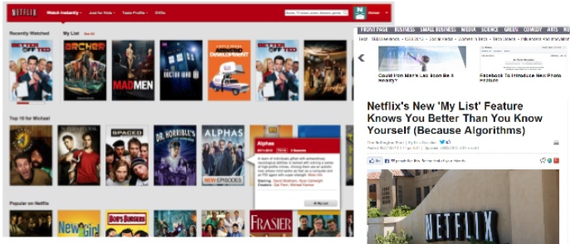
AI – ML – DL: Examples

Slide 46
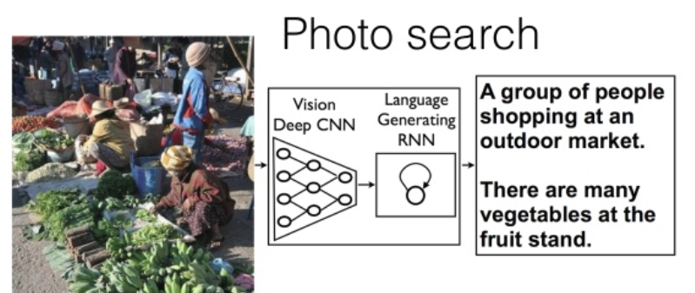
AI – ML – DL: Examples

Slide 47
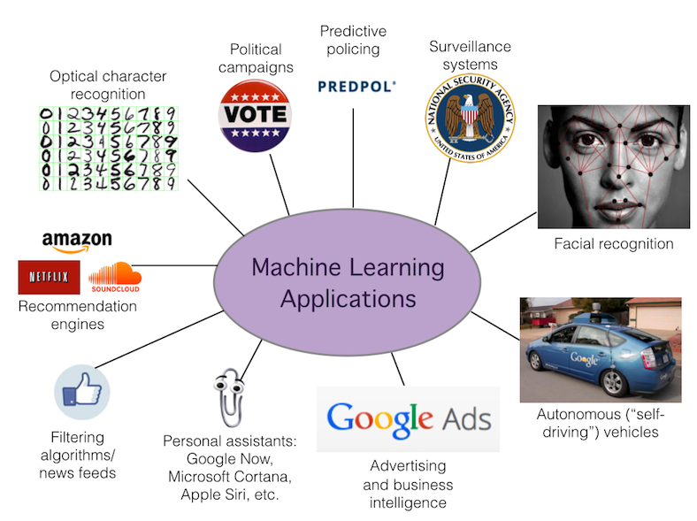
AI – ML – DL: Examples

Slide 48
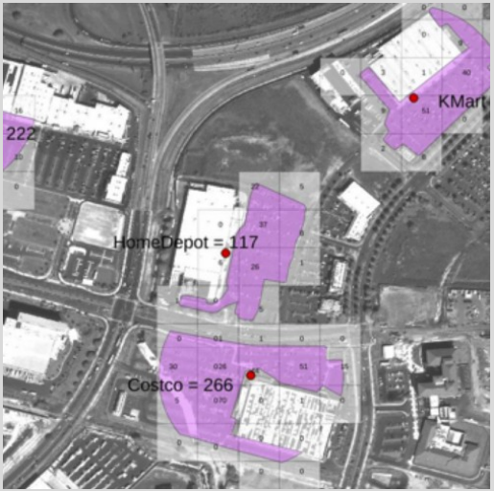
AI – ML – DL: From Satellite Images

Slide 49

AI – ML – DL: Examples

Slide 50
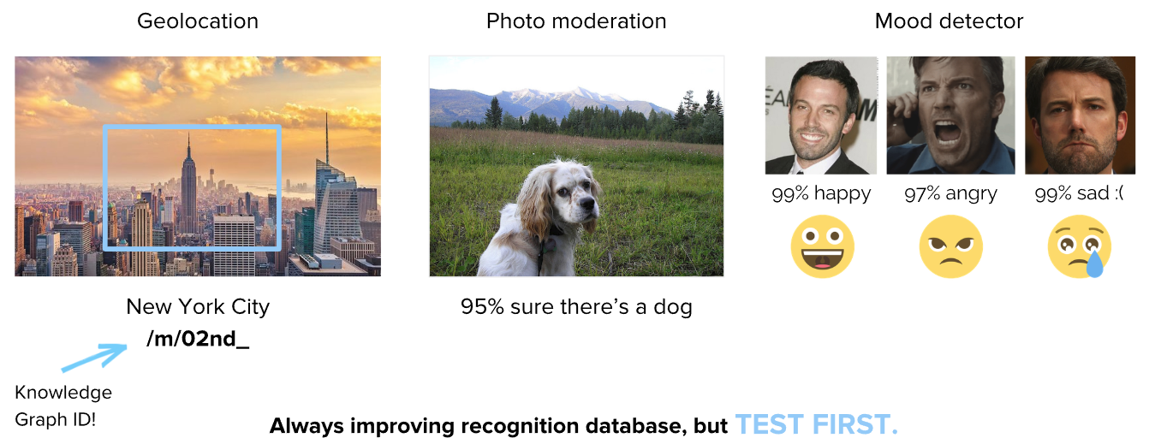
AI – ML – DL: Examples – Google Vision API

Slide 51
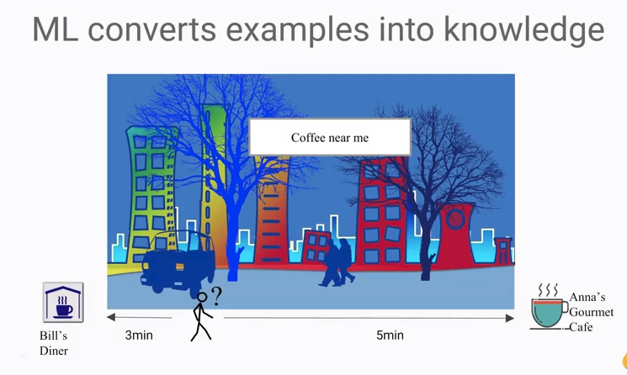
AI – ML – DL: Examples

Slide 52
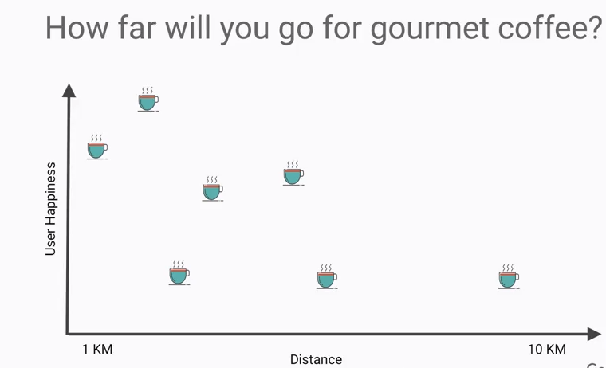
AI – ML – DL: Examples

Slide 53
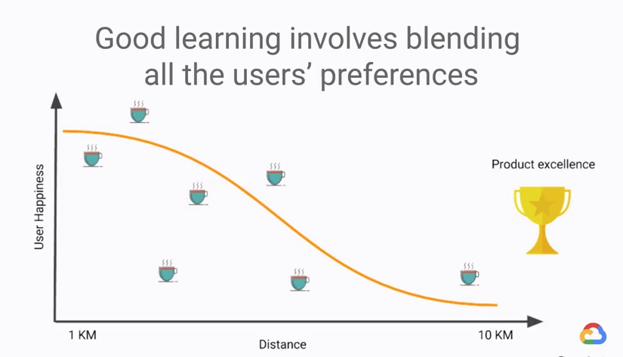
AI – ML – DL: Examples

Slide 54

Recap…

Slide 55
Quiz…
Can you define what is AI, Machine Learning and Deep Learning in a single sentence for each?
Can you think of any other examples of AI/ML/DL that you observe on daily life?

Slide 56


/ AI with Dr Malleswar

Slide 57
Course Outline

